Slide 1
BERT: Pre-training of Deep Bidirectional Transformers for Language Understanding
Authors: Jacob Devlin, Ming-Wei Chang, Kenton Lee, Kristina Toutanova

Slide 2
Introduction
BERT (Bidirectional Encoder Representation from Transformer) : new language representation model
Unlike previous models, BERT designed to pretrain deep bidirectional representations from unlabeled text by jointly conditioning on both left and right context in all layers
Pre-trained BERT model can be fine-tuned with just one additional output layer to create state-of-the-art models for a wide range of tasks

Slide 3
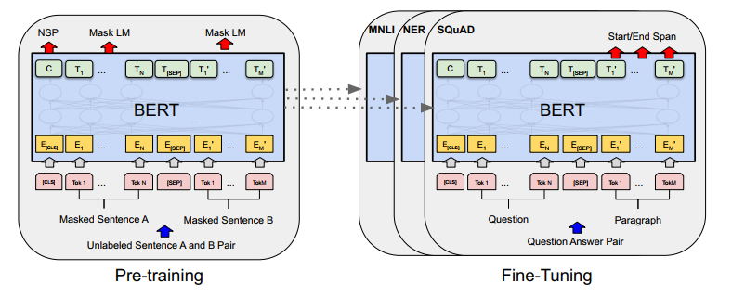
Related work
- Unsupervised feature-based approaches
- Unsupervised fine-tuning approaches
- Transfer learning from Supervised data

Slide 4
BERT
BERT uses a two-step process: pre-training and fine-tuning.
Pre-training: the model is trained on large amount of unlabeled data over different pre-training tasks
Fine-tunning: adjust the pre-trained BERT model for specific downstream tasks using labeled data
Initialize with pre-trained parameters
All the parameters are fined-tunned using labeled data from the downstream task
Each downstream task has separate fine-tuned models
- BERT has unified architecture across different tasks: minimal difference between the pre-trained architecture and the final downstream architecture

Slide 5
BERT Model Architecture
BERT's architecture is a multi-layer bidirectional Transformer encoder based on the implementation described in Vaswani et al. (2017).
L: number of layers, H: hidden size, A: number of self-attention heads
BERT base: L= 12, H=768, A=12, Total Parameters=110M
Have the same model size as OpenAI GPT
BERT transformer: bidirectional self-attention, GPT transformer: constrained self-attention
BERT large: L= 24, H=1024, A=16, Total Parameters=340M

Slide 6
BERT input-output representation
Able to unambiguously represent both a single sentence and a pair of sentences
Sentence: an arbitrary span of contiguous text
Sequence: input token sequence to BERT – a single sentence or two sentences packed together
The model uses WordPiece embedding with a 30,000 token vocabulary
The first token of every sequence is always a special classification token
The sentences are differentiated in two ways: separate with a special token, add a learned embedding to every token indicating whether it belongs to sentence A or sentence B
For a given token, its input representation is constructed by summing the corresponding token, segment, and position embeddings

Slide 7
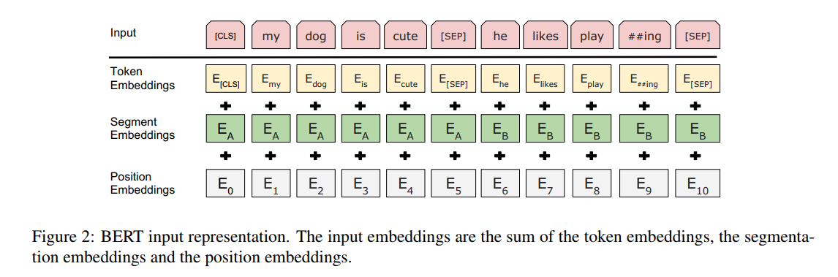
BERT input-output representation

Slide 8
Pre-training BERT
Task #1: Masked LM – mask some percentage of the input tokens at random, and then predict those masked tokens
Task #2: Next Sentence prediction – pre-train for a binarized next sentence prediction task, this helps the model understand the relationship between pairs of sentences
BERT uses a masked language model (MLM) where some tokens in the input are masked, and the model learns to predict these masked tokens -> This approach allows the model to learn bidirectional representation
Fine-tunning BERT: plug in the task-specific inputs and outputs into BERT and fine-tune all the parameters end-to-end

Slide 9
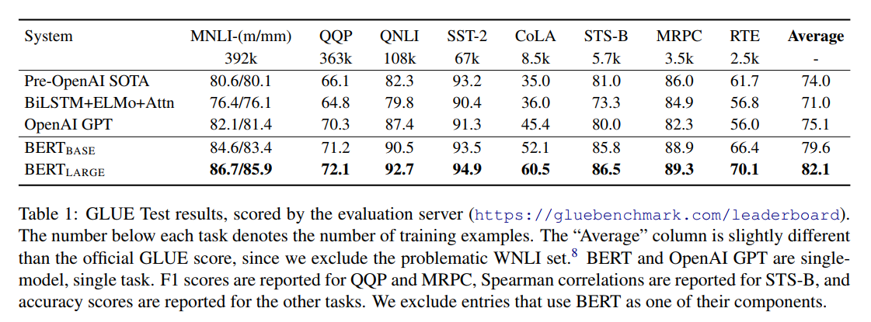
Experiments: GLUE test result

Slide 10
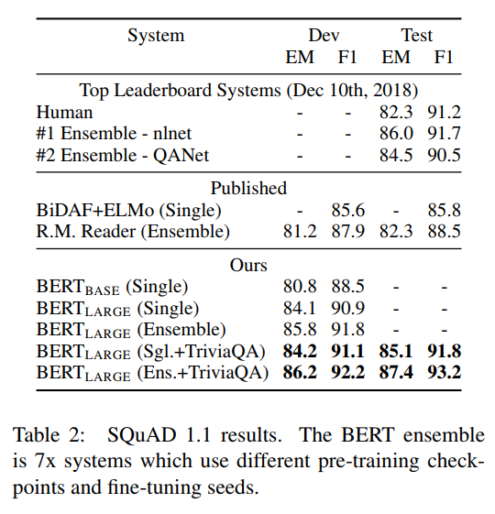
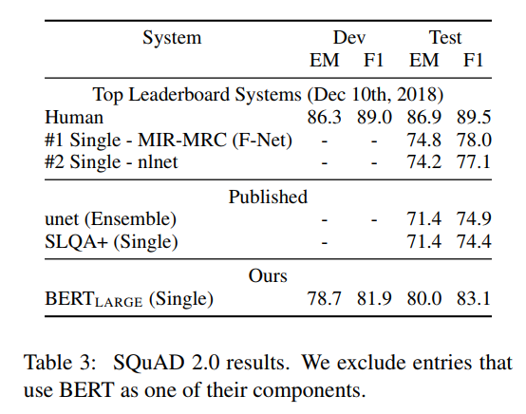
Experiments: SQuAD results

Slide 11
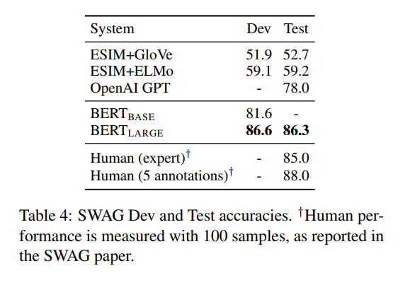
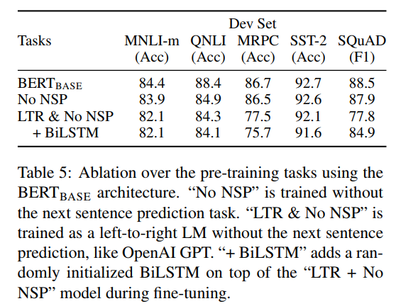
Experiments: SWAG & Ablation studies result

Slide 12
Paper contribution
Demonstrate the importance of bidirectional pre-training for language representation: BERT uses masked language models to enable pre-trained deep bidirectional representations
Pre-trained representations reduce the need for many heavily-engineered task-specific architectures
BERT achieves state-of-the-art results on 11 NLP tasks, including the GLUE benchmark, SQuAD v1.1 and v2.0, and SWAG
It significantly outperforms previous models like OpenAI GPT and ELMo

Slide 13
Thank you

